Slide 1
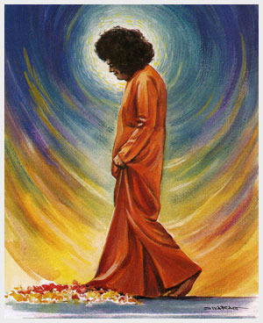
SAI PARENTS- LEAD BY EXAMPLE- LIFE APPLICATIONS


Slide 2
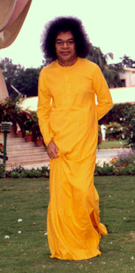
FAITH & SURRENDER

Why get agitated? Let Me take care of all your business. I shall be the one who will think about them. I am waiting for nothing else than your surrender to Me, and then you do not have to worry any more about anything. Say farewell to all fears and discouragement.
You demonstrate that you do not trust Me. On the contrary, you must rely blindly on Me.

Slide 3
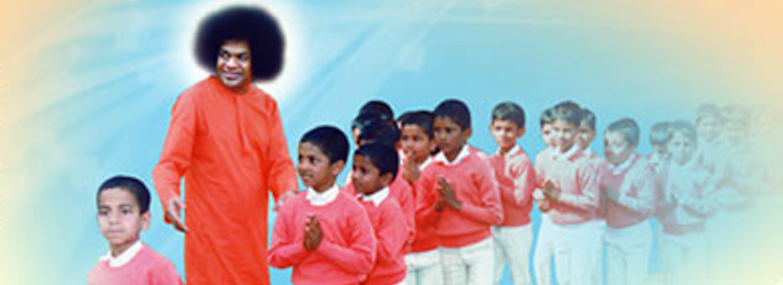
HOW SHOULD PARENTS INVOLVE IN CHILDREN’S ACTIVITIES?

To what extent are parents responsible for the degradation of values among children? Bhagavan: My opinion is that parents are solely responsible for spoiling children. Many parents behave like Dhritarashtra, the blind king of the Mahabharata. He never opposed or prevented his sons, the Kauravas, from doing any type of mischief or misdeed.

Slide 4
SSE TEACHERS – SERVICE RENDERED TO THE CHILDREN ARE MOST SACRED.

Bhagwan gives the qualities which would qualify to be Gurus:
Faith in Baba and in the Sri Sathya Sai Education programs
Capacity to love children as one’s own
Swaadhyaayaa or Self Spiritual Education
Anubhava Jnana or wisdom acquired with personal experience

Slide 5
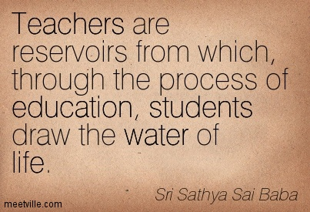
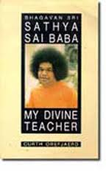
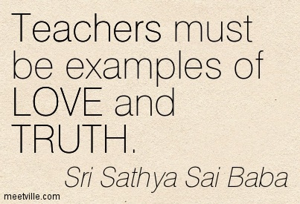
DIFFERENCE BETWEEN INVOLVING & INTERFERING

The father, the mother and the teacher are the three primarily responsible for moulding the future of the country.

Slide 6
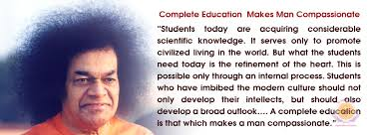
WHAT IS THE AIM OF SSEHV?

To Develop Innate Goodness in Each Child
To Nurture the Children’s awareness that the five Universal Values of Truth, Right Action, Peace, Love and Non-Violence are within them
To achieve Human Excellence through Unity of Thought, Word and Deed

Slide 7
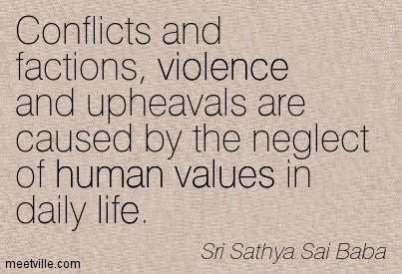
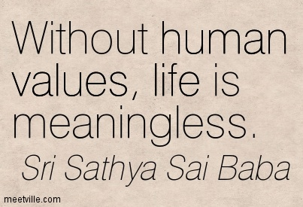
HUMAN VALUES – SATHYA SAI EDUCARE


Slide 8
Nine Point Code Of Conduct

Daily meditation and prayer.
Devotional singing/prayer with family members once per week.
Participation in Sai Spiritual Education by children of the family..
Participation in community service and other programmes of the Organisation.
Regular attendance at devotional meetings conducted by the Organisation.
Regular study of Sathya Sai Baba literature.
Use of soft, loving speech with everyone.
Avoidance of talking ill of others, especially in their absence.
Practice of the principles of “ceiling on desires”, consciously and continuously striving to eliminate the tendency to waste time, money, food, and energy and utilising any savings thereby generated for the service of mankind.

Slide 9
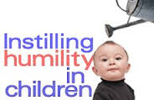
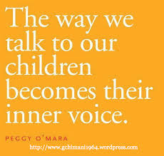
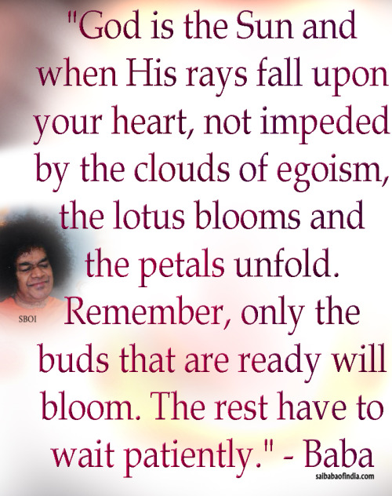
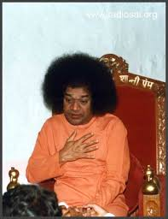
SSE- PRACTICAL CHALLENGES FOR PARENTS AND TEACHERS


Slide 10
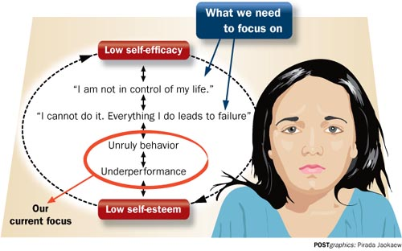
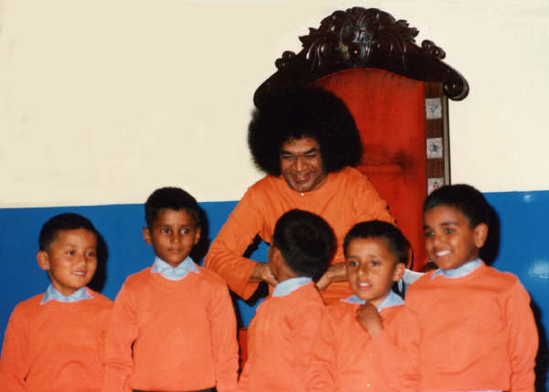
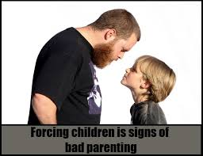
SSE- PRACTICAL CHALLENGES FOR PARENTS AND TEACHERS


Slide 11
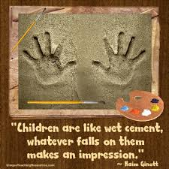
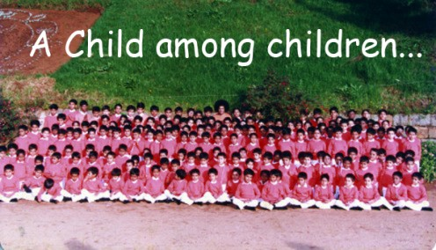
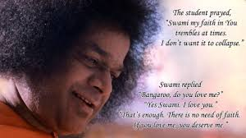
SWAMI’S CHILDREN


